Slide 1


Information Theory
Auref Rostamian, PhD
Research Fellow

Slide 2
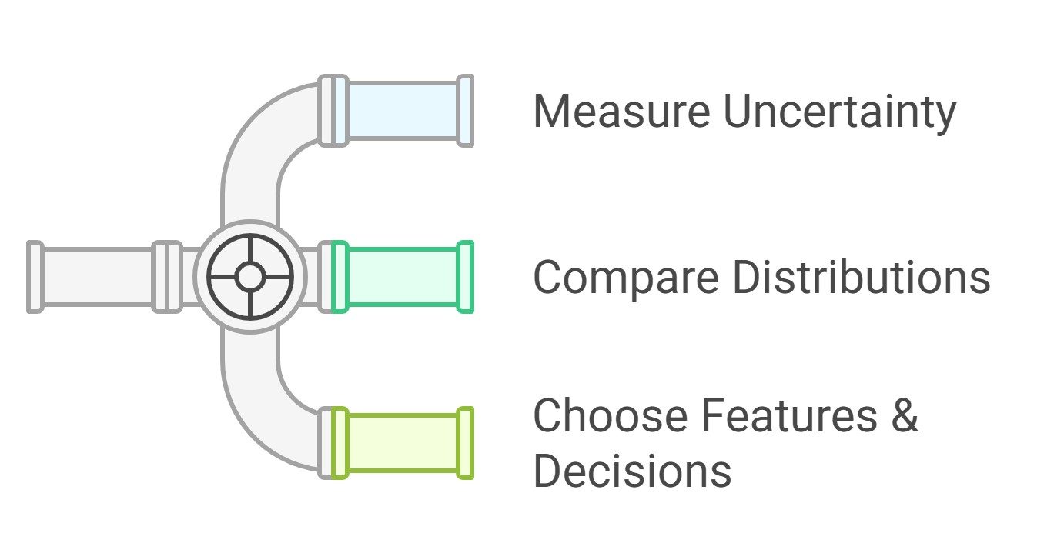
What is Information Theory
A toolkit to measure uncertainty and compare distributions—useful for loss functions, feature selection, and model evaluation.
I(X) = -log(P(X))
Rare outcomes ⇒ larger I(X)

Slide 3
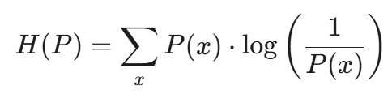
Entropy: The Average Uncertainty
Entropy (H(P)) is the average surprise packed into an entire probability distribution (P). It quantifies the inherent uncertainty or randomness of the system.
Entropy is the expected value of the surprisal:
Code a discrete probability distribution in Python
Calculate the entropy for this distribution
P(x): The true probability of outcome x.
log(1/P(x)): The surprisal of outcome x.

Slide 4
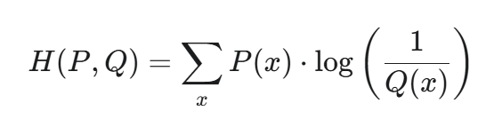
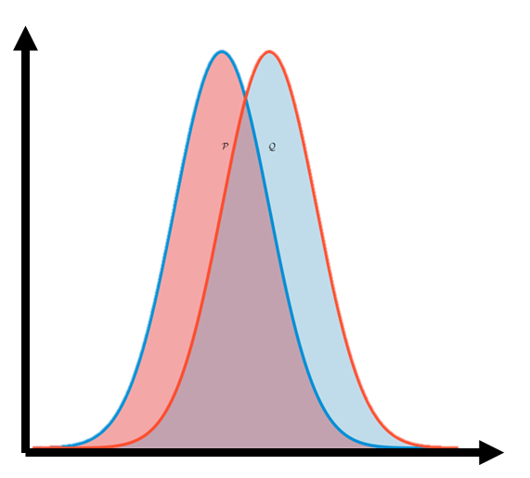
Cross-Entropy: Surprise from a Bad Model
Definition
Cross-Entropy (H(P,Q)) is the average surprise you expect when observing a process generated by the true distribution (P) while believing it comes from your model (Q).
P(x): The true probability used to weight the average outcome.
log(1/Q(x)): The surprisal based on your model's belief (Q).
Code two discrete probability distributions in Python
Calculate the cross entropy for these distributions

Slide 5
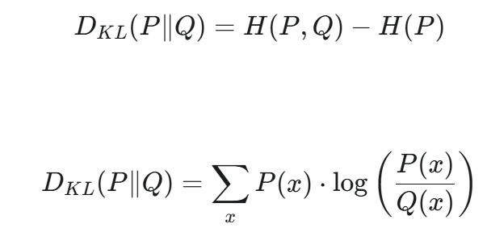
KL Divergence: Isolating the Model Error
Definition
Kullback-Leibler (KL) Divergence (D KL​ (P∥Q)), or Relative Entropy, isolates the extra surprise caused purely by using the wrong model (Q) instead of the true distribution (P).
H(P,Q)
D_{KL} (P||Q)
H(P)
D _{KL}(P∥Q)≥0. It is zero only when P and Q are identical.
Believing in the wrong model (Q) can only increase the surprise you get, never decrease it.

Slide 6

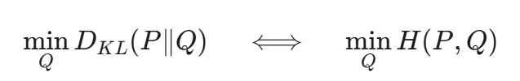
The Crucial Equivalence in Machine Learning
The ultimate goal of training many machine learning models (Q) is to build the best possible approximation of the true distribution (P). This means we need a loss function to minimize.

Slide 7
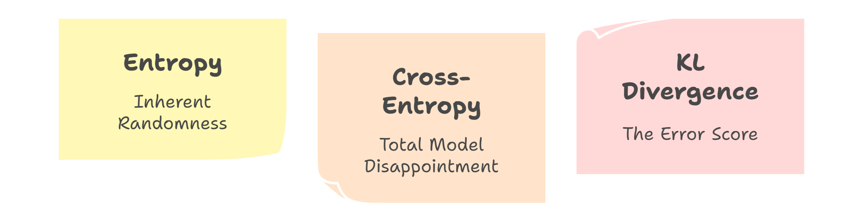
Takeaway message

